Slide 1
Lecture 13: Array and Vector – Part III
Class page: https://github.com/tsung-wei-huang/cs1410-40
Dr. Tsung-Wei Huang
Department of Electrical and Computer Engineering
University of Utah, Salt Lake City, UT
Notes:
Morning everyone
Today we are looking into control flow in C++.

Slide 2
String
The string in C/C++ is a series of characters that are treated as a single unit
Written in double quotes, ex: “Hello”
In C, strings are arrays of characters that end with an extra character '\0‘ (NULL, ASCII code=0)
Ex: ‘H’, ‘e’, ‘l’, ‘l’, ‘o’, ‘\0’ (6 elements)
Not convenient to deal with
C++ standard library class string provides more powerful capabilities

Slide 3
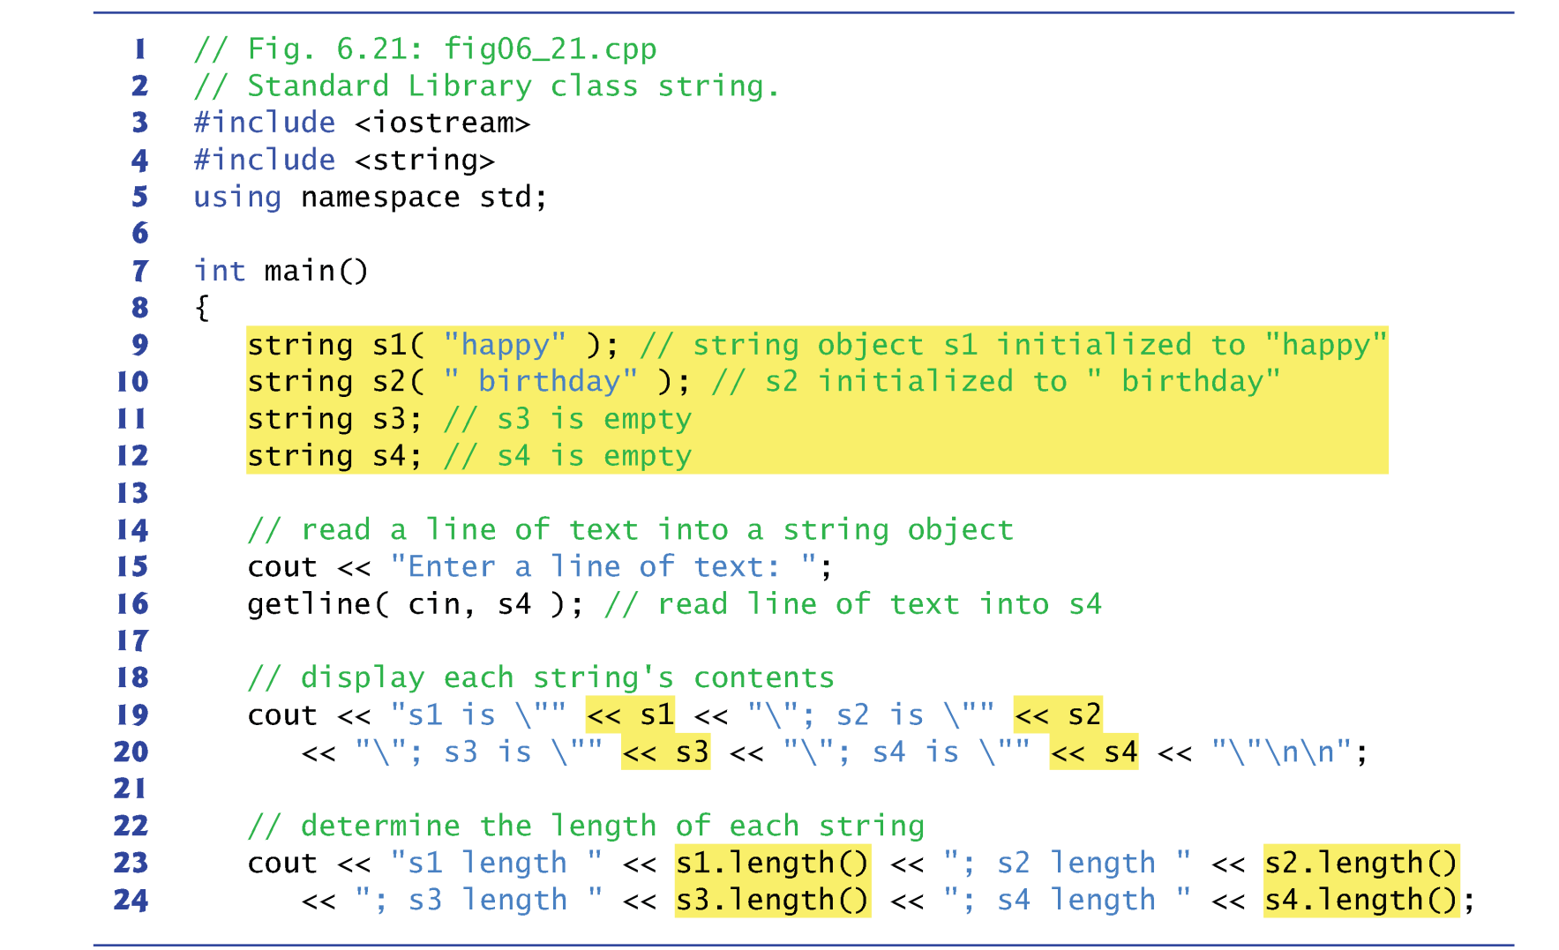
String

Slide 4
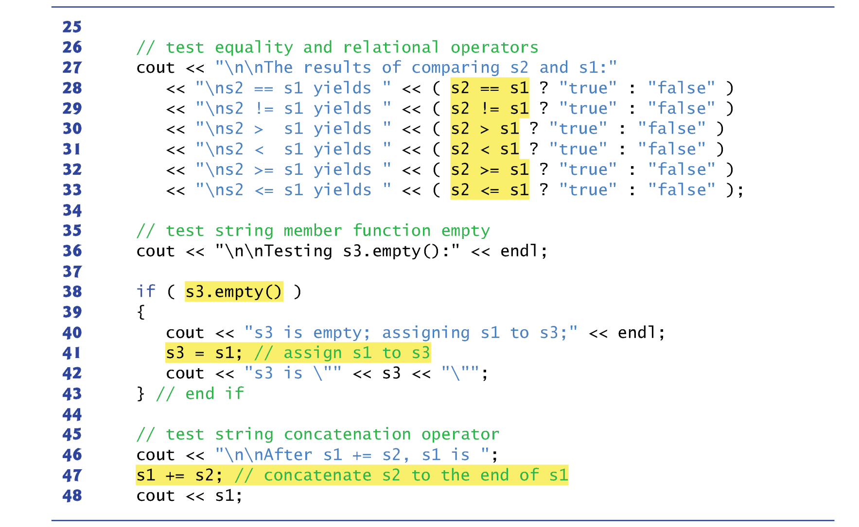
String

Slide 5
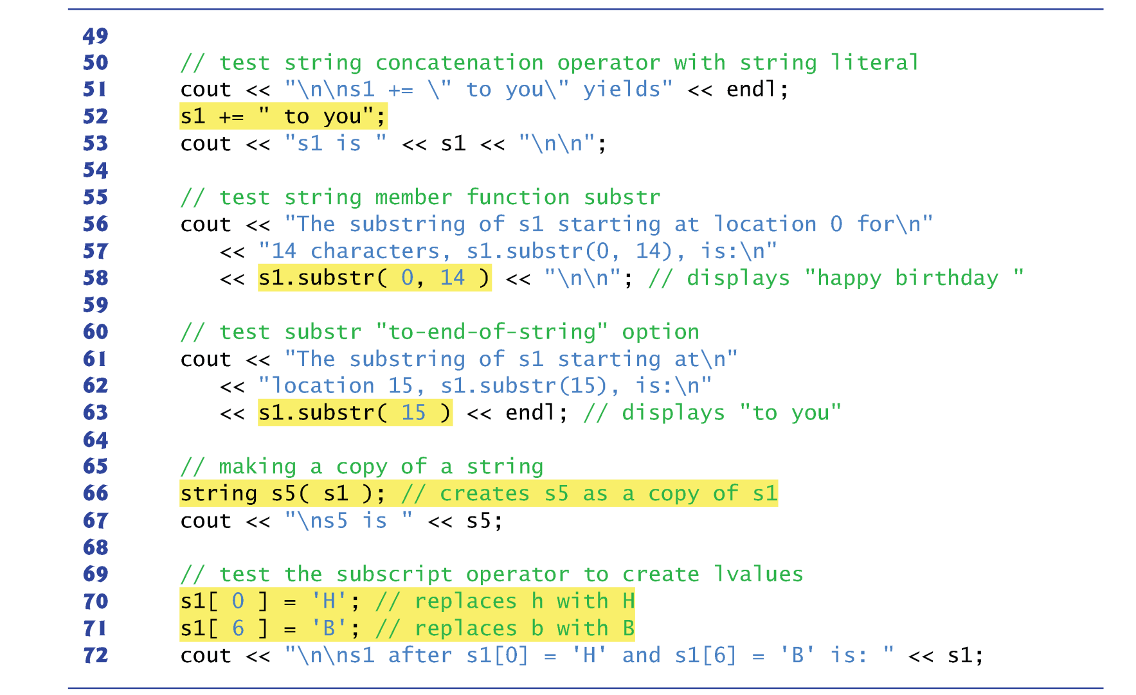
String

Slide 6
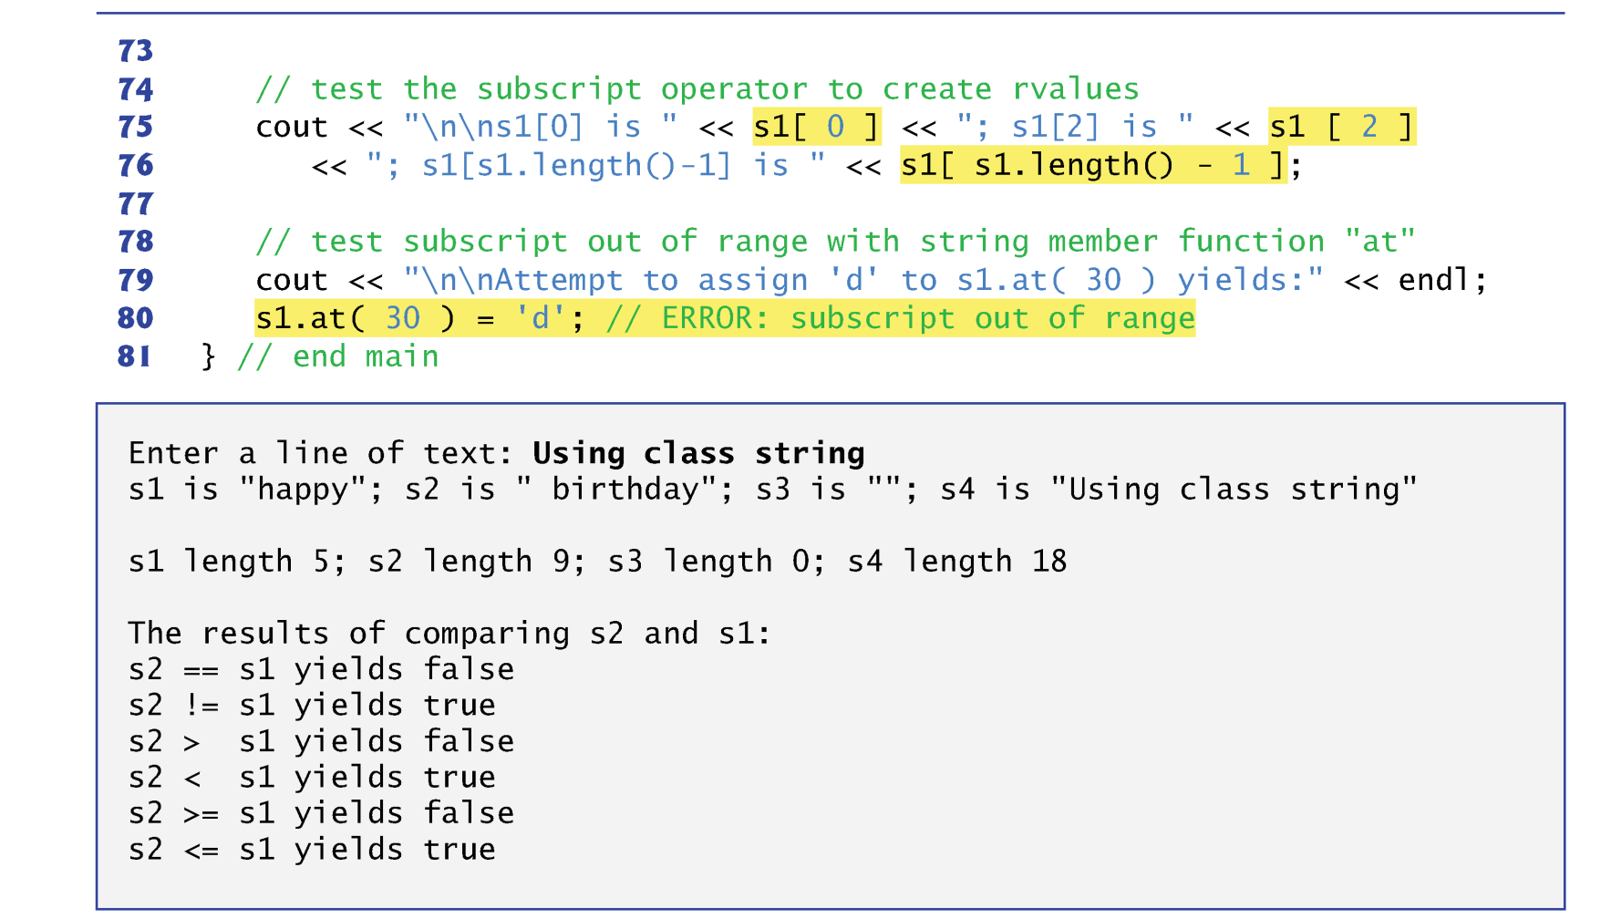
String

Slide 7
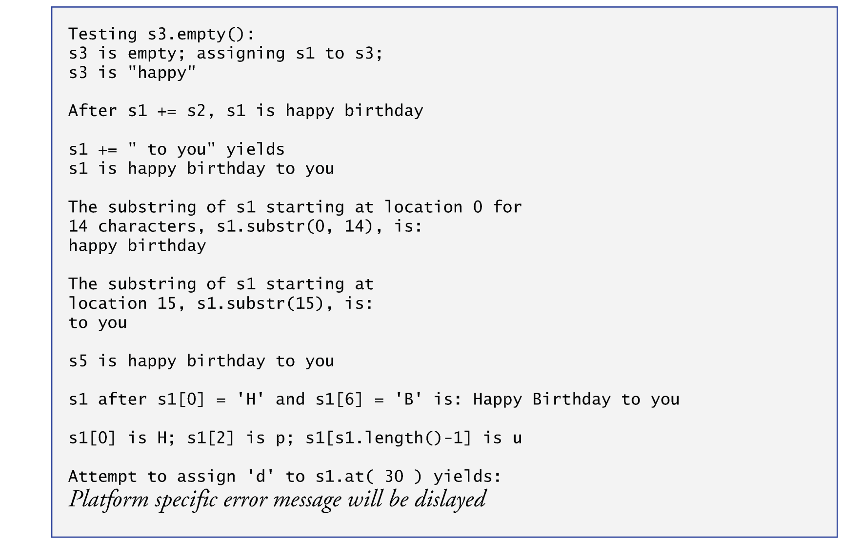
String

Slide 8
Example: Count Frequency
Given a string s, count the frequency of alphabets
Example: afeqfasc
Output:
a: 1
b: 0
c: 1
…
f: 2
…
s: 1

Slide 9
Summary
Array
Vector
String
One of the most commonly used data structures
Can represent “human-readable data”

